Slide 1

Images

Slide 2

Image
To put an image on a webpage, we use the image element.
Tag: <img>
Note: Images are not technically inserted into a webpage; images are linked to web pages.

Slide 3
Example
src - specifies the path of the image
alt – specifies an alternate text for the image
width – defines the width of the image in pixels.
height – defines the height of the image in pixels.
Ex: <img src="facebookpng.png" alt="Facebook Logo" width="100" height="100">

Slide 4
Image Formats
GIF
SVG
JPG or JPEG
PNG

Slide 5
GIF
Stands for Graphic Interchange Format
Does well compressing large areas of single-color
Limited color space of 256 colors.
Can do transparency, with jagged edges.
Can have multiple frames and make a little movie.
File Extension: .gif

Slide 6
SVG
Stands for Scalable Vector Graphics
Logos, icons, etc.
Vector File
File Extension: .svg

Slide 7
JPG
Stands for Joint Photographic Export Group
You can pick a balance between quality and file size.
File Extension: .jpg or.jpeg

Slide 8
PNG
Portable Network Graphics
Images that need transparency
File Extension: .png

Slide 9
Images
CSS can do one image file to be shown at any size but a big, high-resolution image contains millions of pixels. All that data can make the file size big which takes a lot of time to download on a slow connection and can use up people’s data plans and in some markets cost them a lot of money.

Slide 10
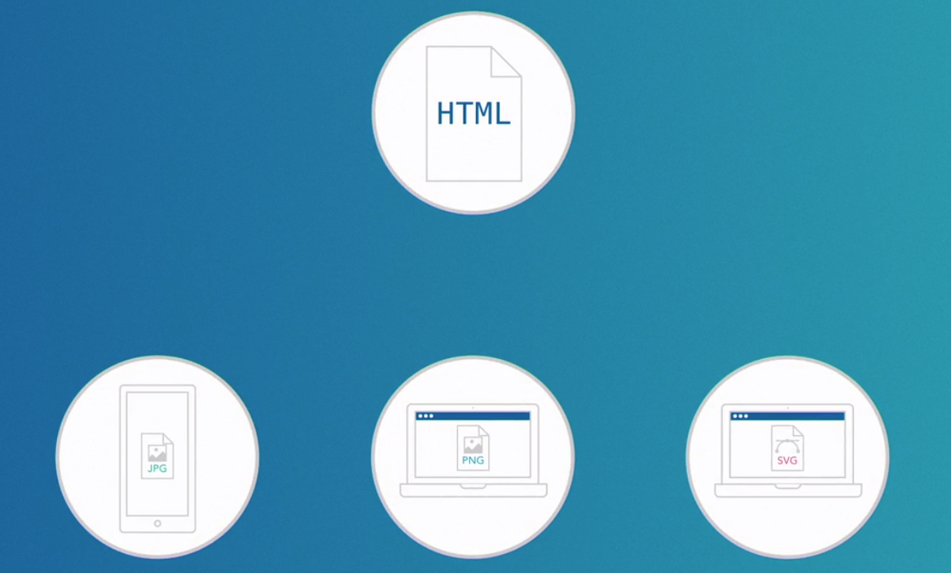

Slide 11



Slide 12
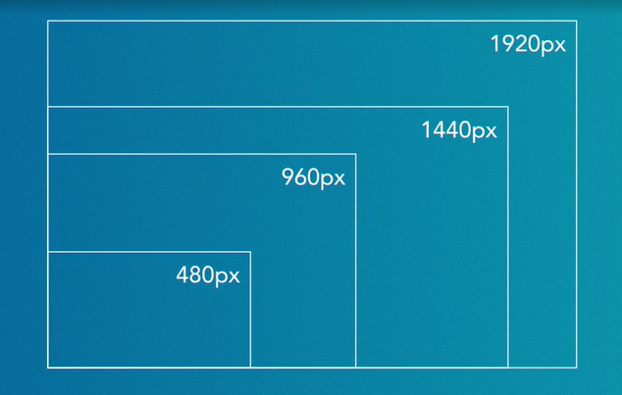

Slide 13
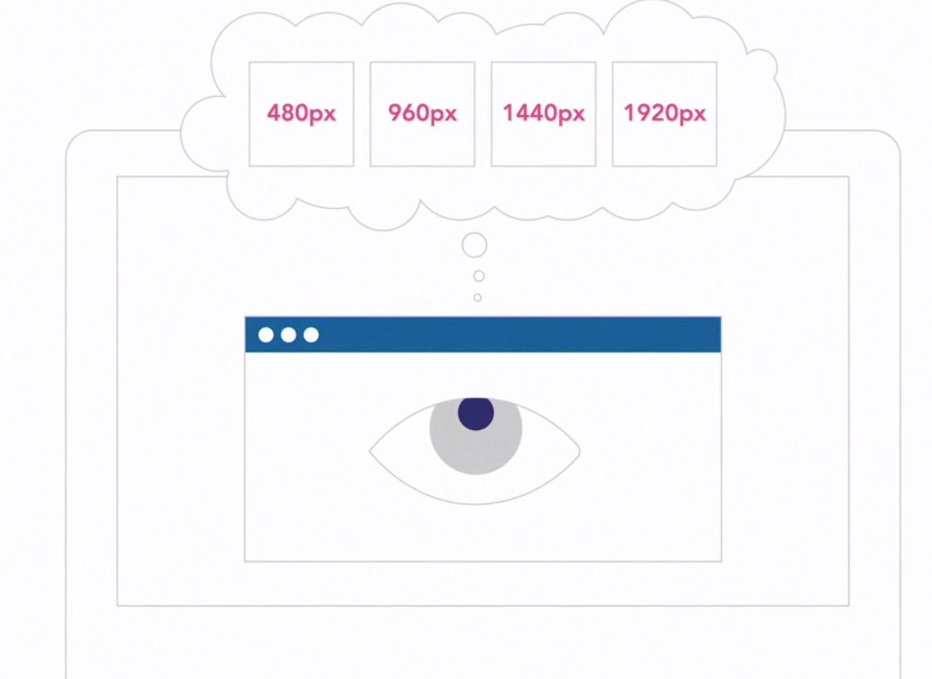

Slide 14
Viewport Width and Physical Width
Viewport Width | Physical Width of the Screen
User’s visible area of the screen. | refers to the actual width of the device's screen

Slide 15
Images
The width and height attributes describe the intrinsic aspect ratio of the image.
The descriptors in the srcset attribute specify the available widths of different image versions in pixels, aiding in responsive image loading based on device capabilities.

Slide 16
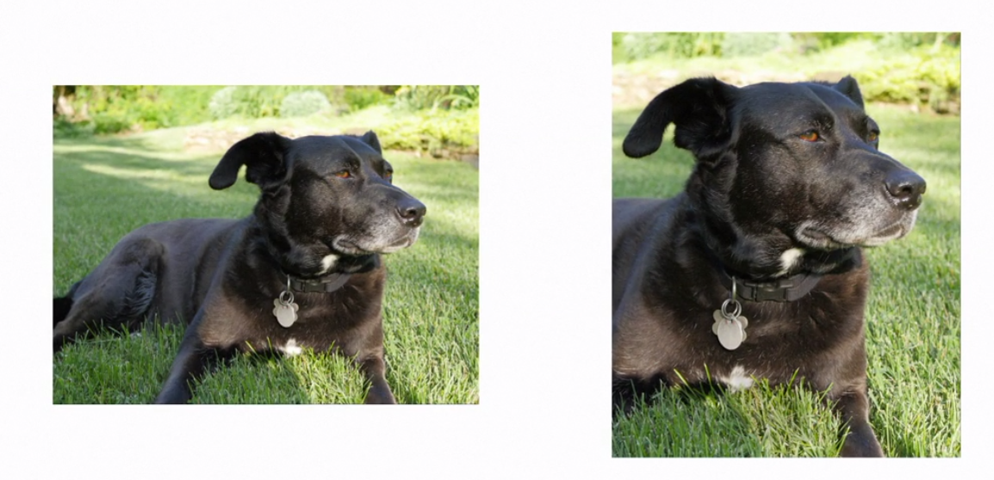
Responsive Picture
Big Screen
Small Screen

Slide 17
<picture>
<picture> tag is important for flexibility in specifying image resources.
The <picture> element contains two tags: one or more <source> tags and one <img> tag.
<source> tag indicates files or browsers to choose from

Slide 18
<picture>
The browser will look for the first <source> element where the media query matches the current viewport width, and then it will display the proper image (specified in the srcset attribute). The <img> element is required as the last child of the <picture> element, as a fallback option if none of the source tags matches.

Slide 19
Figures and Figcaption
For the search engines and AI to know that two pieces of content are related to each other we will be using figures.
<figure>
- For anything that appears as a figure like images and tables, illustrating something.
<figcaption>
- For demonstration of a concept that needs a caption

Slide 20
Audio and Video

Slide 21
Audio
<audio> tag is used to place audio.
Attribute | Description
src | specifies the url of the audio file
controls | specifies that audio controls should be displayed (such as a play/pause button etc)
autoplay | specifies that the audio will start playing as soon as it is ready
muted | specifies that the audio output should be muted
loop | specifies that the audio will start over again, every time it is finished

Slide 22
Video
Attribute | Description
src | specifies the url of the video file
controls | specifies that video controls should be displayed (such as a play/pause button etc)
autoplay | specifies that the video will start playing as soon as it is ready
muted | specifies that the audio output should be muted
loop | specifies that the video will start over again, every time it is finished
Poster | Specifies an image to be shown while the video is downloading, or until the user hits the play button
Width/height | Specifies the width or height of the video
<video> tag is used
to play video files.

Slide 23
Subtitles and Captions

Slide 24
Subtitle and Captions
Captions | Subtitles
Assume the viewer can’t hear anything, and include non-speech elements like speaker identifications and sound effects. | Assume that the viewer can hear everything but can’t understand language, and translate spoken dialogue
Are considered an accessibility aide | Are more associated with foreign language translation

Slide 25
Subtitle and Captions
To create subtitles for an audio or video, use the <track> tag.
This tag is used to specify subtitles, caption files or other files containing text, that should be visible when the media is playing.
Tracks are formatted in WebVTT format (.vtt files).

Slide 26
Subtitle and Captions
To create subtitles for an audio or video, use the <track> tag.
This tag is used to specify subtitles, caption files or other files containing text, that should be visible when the media is playing.
Tracks are formatted in WebVTT format (.vtt files). (Web Video Text Tracks)

Slide 27
<track> attributes
Attribute | Definition
kind | indicates the type of content the files contain
label | indicates which language that subtitle is set for
src | assigned a valid url pointing to the relevant webvtt subtitle file in each case
srclang | indicates what language each subtitle files contents are in
default | indicates the default subtitle file definition to use

